Slide 1
Office 365 development
Office add-ins best practices and guidelines Overview
Dean Slawson

Slide 2
Office add-ins A new way to build extensions for Office
Contextual mail add-in
Add-in launched contextually from a mail message or appointment
Outlook and Outlook Web Access (OWA)
Task pane add-in
Add-in that runs beside a document/mail with read/write access
Word, Excel, PowerPoint, Project, Outlook
Content add-in
Add-in that runs within a document content with read/write access
Excel, PowerPoint, Access
Add-in command
Command in the Office UI to launch add-in or perform UI-less operation
Outlook, Outlook Web Access (OWA)

Slide 3
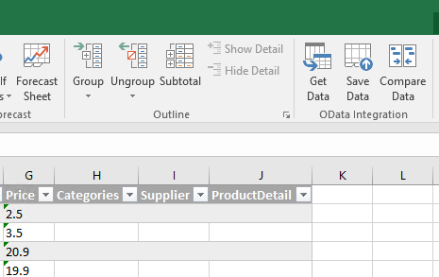
Add-in commands (coming soon to Office 2016)
Custom UI hooks into Office applications
Entry points
Buttons on ribbon
Contextual menus
Actions
ShowTaskpane
ExecuteFunction
https://msdn.microsoft.com/en-us/library/office/mt267546.aspx

Slide 4
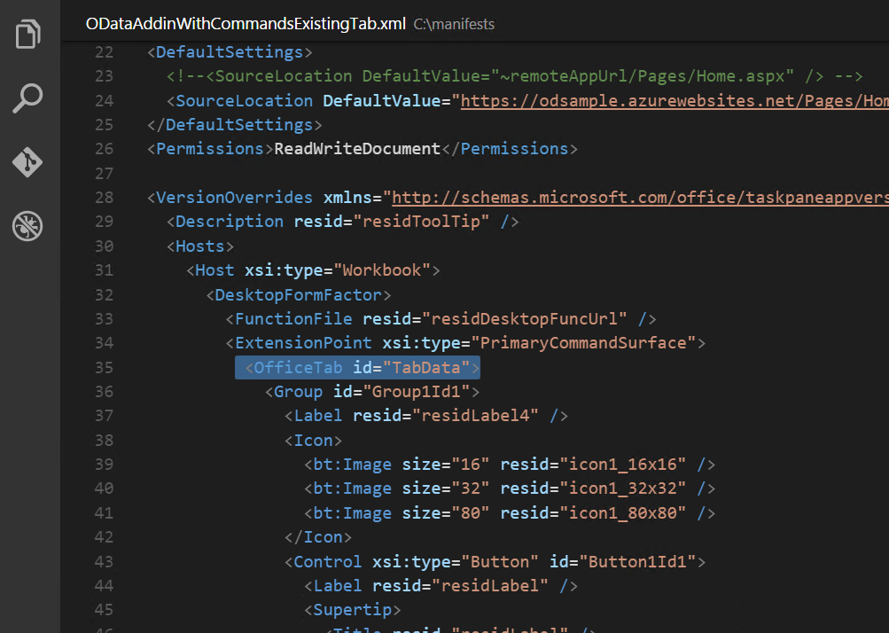





Building an add-in is simple, it’s just like a website
HTML
manifest.xml Deeply integrate into Office
Your own web app Host it anywhere, update it anytime
Office add-in Run it anywhere that Office runs
Use any web framework

Slide 5
Add-in best practices
https://msdn.microsoft.com/EN-US/library/office/mt590883.aspx
Functional & UX design
Design for deep value
First run
Sign-in
Add-in commands
UX quality
Performance
Marketing,
GTM
Store listing
Marketing
Website
Monitor
User voice & reviews
Update regularly
Post-launch

Slide 6
Best practices
https://msdn.microsoft.com/EN-US/library/office/mt590883.aspx
Functional & UX design
Design for deep value
First run
Sign-in
Add-in commands
UX quality
Performance
Marketing,
GTM
Store listing
Marketing
Website
Serving
Monitor
User voice & reviews
Update regularly
Post-launch
Learning
Selling

Slide 7
Functional and UX design best practices overview

Slide 8
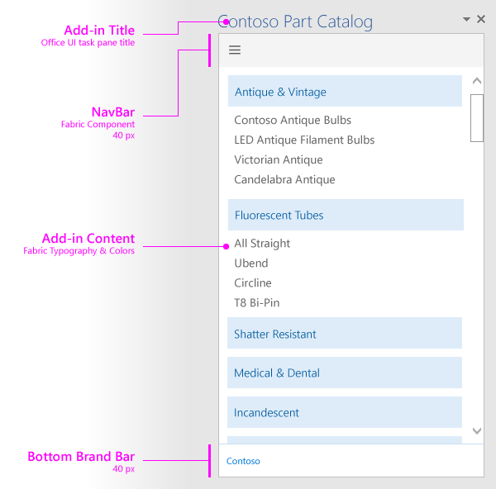
Add-in design guidelines and principles
Design explicitly for Office. The functionality and look and feel of an add-in should harmoniously complement the Office experience
Make users more productive. Help users do more or get one job done quickly. Enable seamless interaction between Office and your add-in
Favor content over chrome. Emphasize the add-in's content and functionality over any accessory chrome. Avoiding superfluous UI elements that don't add value to the user experience
Keep users in control. Allow users to understand any important decisions, control their experience, and easily reverse actions the add-in performs
Design for all Office platforms and input methods. Support mouse/keyboard and touch input devices. Ensure UI is responsive to adapt to different form factors. Ensure accessibility needs are met
UX guidelines article: https://msdn.microsoft.com/en-us/library/office/mt484317.aspx

Slide 9
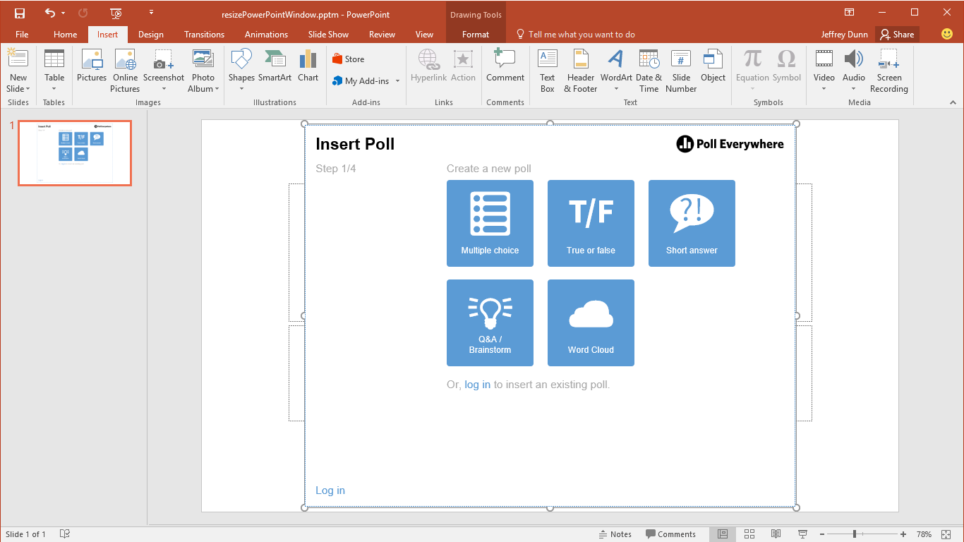
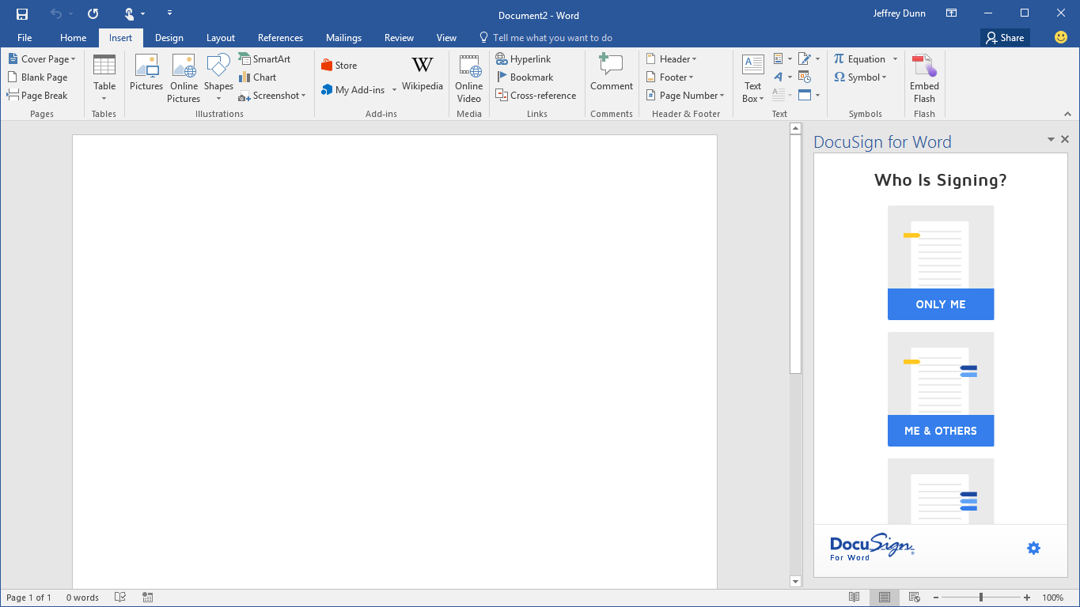
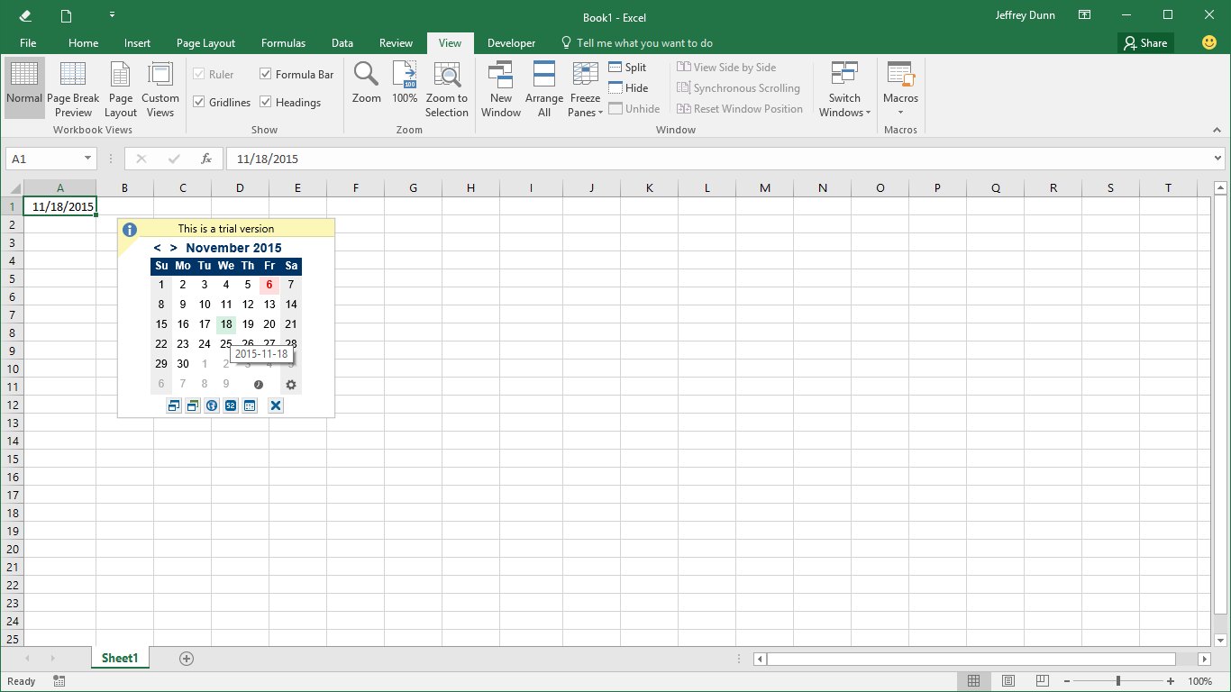
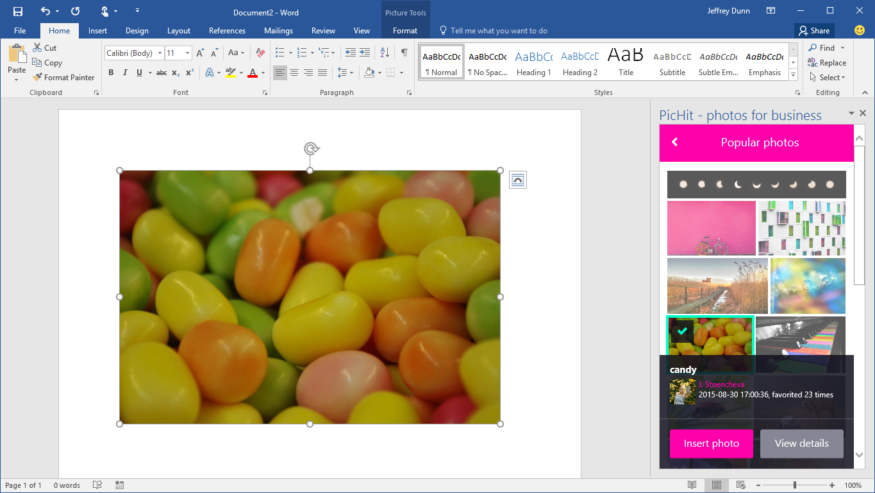
Offer deep value to your users
Add-ins must complement Office. Help users complete their tasks quickly and efficiently
Focus on scenarios and workflows that make sense in each of the Office applications
Provide strong reasons for users to engage with the add-in

Slide 10
Offer deep value to your users Support core authoring tasks
PicHit.Me provides quick and easy access to hi-res legally cleared photos
Helps users create more meaningful and attractive content
Increases confidence in security and safety of content
Enables faster creation

Slide 11
Offer deep value to your users Enable new scenarios
Poll Everywhere enables new scenarios inside of PowerPoint. Pose questions, get answers and collate feedback in real-time
Aids communication, collaboration, and connection
Compliments PowerPoint
Provides new unique functionality

Slide 12
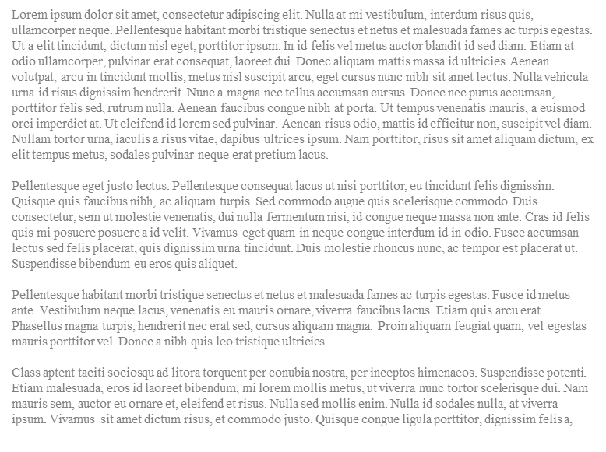
Offer deep value to your users Embed complementary services
DocuSign enables scenarios inside Office by embedding its service as a complement to documents.
Increases productivity through proximity and embedding
Simple gestures like drag and drop enhance the ease
Integrates deeply with OneDrive

Slide 13
Offer deep value to your users Improve the Office experience
Mini-calendar date picker customizes and improves the Excel data entry experience
Speeds up data entry
Compliments Excel
Enables productivity

Slide 14
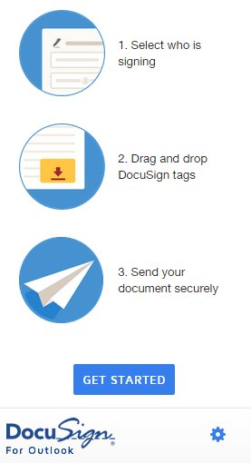
First run experiences that quickly engage users
Personalize and greet the user
Describe clearly the value your add-in offers before asking users to sign-in
Don’t assume users know how it works. Be prepared to show teaching UX and videos
Give free trials out of the box (no sign-ups). Freemium is good and mitigates user drop-offs. Show/tease the premium features
Keep new user sign-up dead simple. Prefill info you already have: email, display name. Skip email verifications

Slide 15
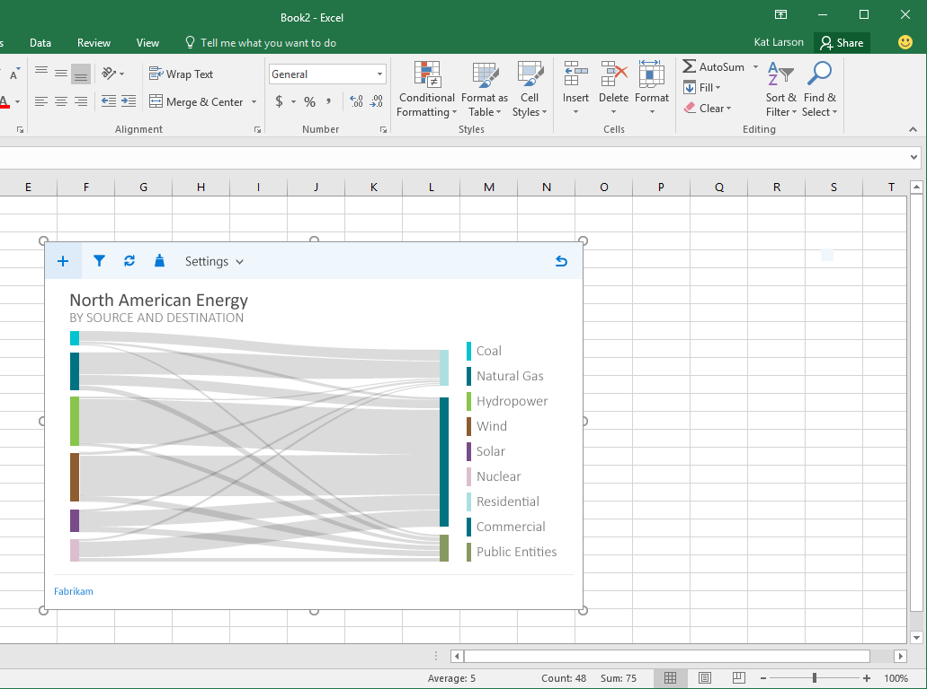
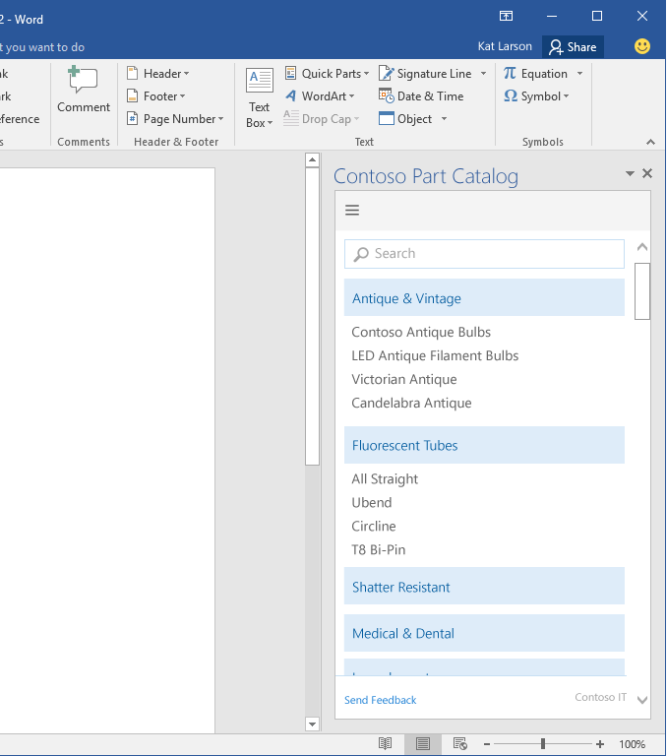
Use Office Fabric UI
http://dev.office.com/fabric
Nav Bar
component
Icons
Command Bar
component
Give UI space
Neutral colors default Office font
Notes:
Add call-outs as appropriate to this slide
Design for mobile first, touch experience. Fabric helps here. Test across platforms/browsers
Use Office UI Fabric for custom HTML UI
Icons – Use fabric icons for a style that fits with Office
Typography – Use the typographic ramp provided in fabric to create layout hierarchy
Color – Use the Fabric neutral and theme colors to accent your add-in
Use Office UI Fabric Components – reusable layotus for common UI elements
Search boxes
App bar overflows
For content add-ins and match default theme
Use Calibri for content font
Choose neutral colors for data labels – allow the content to shine not your UI
Follow accent colors of common chart objects
Give your UI space, use margins and padding to avoid visual bugs that lead to less confidence
Fit within window even at 768px height

Slide 16
Marketing and GTM best practices overview

Slide 17
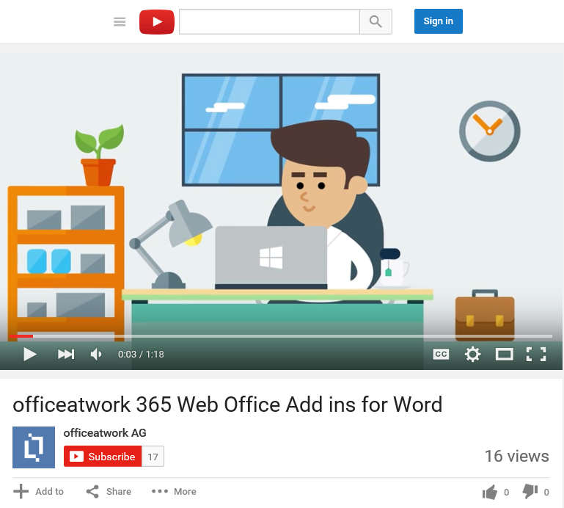
Website and marketing
Your listing in the Office Store
Create and promote a robust trial experience of your add-in
Add videos, screenshots, and in-product training and tips to your add-in to show users the value and how it works
Create and promote a dedicated website for your add-in. This is an important conduit to the Store to increase downloads
Promotional videos and emails can also help drive traffic
Microsoft promotion of add-ins

Slide 18
Post launch and monitoring best practices overview

Slide 19
Update and improve your add-in
Monitor
Monitor your add-ins. Know when things are broken and fix ASAP
Uservoice and reviews
Ask users to review your add-in
Create a uservoice channel to collect feedback
Address users feedback in reviews and uservoice. Respond when issues are fixed
Regular updates
Add new features, update your UX anytime. Users will see your improvements immediately!
Consider A/B testing your UX revisions
Security or privacy issues must be fixed in real-time

Slide 20
Further reading…
Getting started with Office add-ins
Office add-in code samples
Office add-in training videos & hands on labs
Office add-in snack videos
Office add-in documentation
Office UI Fabric
Design guidelines for Office add-ins

Slide 21
Thank you

Slide 23
How can we help you make great add-ins?
More content or examples?
best practices, sample code…
Better tools?
cross-platform debugging, telemetry, analytics…
Improved publishing process?
Improved add-in discoverability?
What else?
Send feedback to:
FEEDBACK LINK

Slide 24
References
https://dev.office.com/getting-started/addins
Use Office UI Fabric in add-ins
Office add-in UX guidelines

